Slide 1
Ch:1 Introduction to Artificial Intelligence
Spring Semester 2019
Instructor: Engr. Saeeda Kanwal(Lecturer) saeeda.kanwal@nu.edu.pk

Slide 2
Today’s Lecture
What is intelligence? What is artificial intelligence?
A very brief history of AI
Modern successes: Stanley the driving robot
Foundations of AI
AI state of Art
How much progress has been made in different aspects of AI

Slide 3
What is Intelligence?
Intelligence:
“the capacity to learn and solve problems”
in particular,
the ability to solve novel problems
the ability to act rationally
the ability to act like humans
Artificial Intelligence
build and understand intelligent entities or agents
2 main approaches: “engineering” versus “cognitive modeling”
Cognitive modeling: process of comprehension and prediction

Slide 4
What’s involved in Intelligence?
Ability to interact with the real world
to perceive, understand, and act
e.g., speech recognition and understanding and synthesis
e.g., image understanding
e.g., ability to take actions, have an effect
Reasoning and Planning
modeling the external world, given input
solving new problems, planning, and making decisions
ability to deal with unexpected problems, uncertainties
Learning and Adaptation
we are continuously learning and adapting
our internal models are always being “updated”
e.g., a baby learning to categorize and recognize animals

Slide 5
What is Artificial Intelligence?
What is artificial intelligence?
It is the science and engineering of making intelligent machines, especially intelligent computer programs. It is related to the similar task of using computers to understand human intelligence, but AI does not have to confine itself to methods that are biologically observable.
Views of AI fall into four categories:
Thinking Humanly | Thinking Rationally
Acting Humanly | Acting Rationally

Slide 6
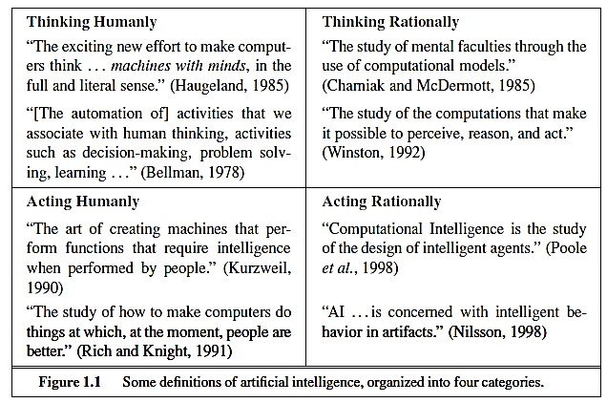
Categories

Slide 7
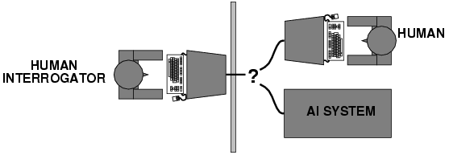
Acting humanly: Turing test
Alan Turing (1950) "Computing machinery and intelligence“
"Can machines think?" → "Can machines behave intelligently?“
Operational test for intelligent behavior: the Imitation Game
It was designed to provide a satisfactory operational definition of intelligence. A computer passes the test if a human interrogator, after posing some written questions, cannot tell whether the written responses come from a person or from a computer.

Slide 8
What would a computer need to pass the Turing test?
The computer would need to possess the following capabilities:
Natural Language Processing: to enable it to communicate successfully in English.
• Knowledge Representation: to store what it knows or hears.
• Automated Reasoning: to use the stored information to answer questions and to draw new conclusions.
• Machine learning: to adapt to new circumstances and to detect and extrapolate patterns.
Vision (for Total Turing test): to recognize the examiner’s actions and various objects presented by the examiner.
Motor control (total test): to act upon objects as requested.
Other senses (total test): such as audition, smell, touch, etc.

Slide 9
Thinking humanly: The cognitive modeling approach
Requires detailed matching of computer behavior and timing to detailed measurements of human subjects gathered in psychological experiments.
Cognitive Science approach
Try to get “inside” our minds
E.g., conduct experiments with people to try to “reverse-engineer” how we reason, learning, remember, predict
So, we need to get inside the actual workings of human minds.
There are three ways to do this:
through introspection—trying to catch our own thoughts as they go by;
through psychological experiments—observing a person in action;
and through brain imaging—observing the brain in action.

Slide 10
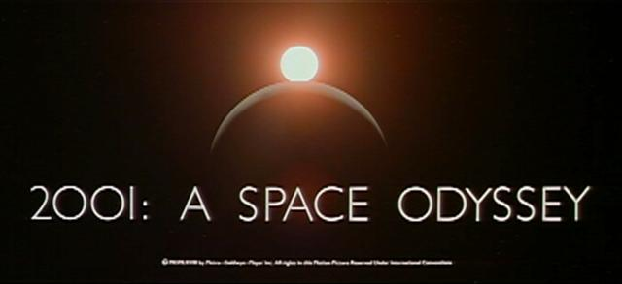
HAL: from the movie 2001
2001: A Space Odyssey
classic science fiction movie from 1969
HAL
part of the story centers around an intelligent computer called HAL
HAL is the “brains” of an intelligent spaceship
in the movie, HAL can
speak easily with the crew
see and understand the emotions of the crew
navigate the ship automatically
diagnose on-board problems
make life-and-death decisions
display emotions
In 1969 this was science fiction: is it still science fiction?

Slide 11
Consider what might be involved in building a computer like Hal….
What are the components that might be useful?
Fast hardware?
Chess-playing at grandmaster level?
Speech interaction?
speech synthesis
speech recognition
speech understanding
Image recognition and understanding ?
Learning?
Planning and decision-making?

Slide 12
Thinking Rationally: Laws of Thought
Formalize “correct” reasoning using a mathematical model (e.g. of deductive reasoning/logical conclusion).
Logics Program: Encode knowledge in formal logical statements and use mathematical deduction to perform reasoning:
Problems:
-Formalizing common sense knowledge is difficult.
-General deductive inference is computationally
intractable.

Slide 13
Acting Rationally: The Rational Agent
An agent is an entity that perceives its environment and is able to execute actions to change it.
Agents have inherent goals that they want to achieve (e.g.survive, reproduce).
A rational agent acts in a way to maximize the achievement of its goals.
True maximization of goals requires omniscience and unlimited computational abilities.
Limited rationality involves maximizing goals within the computational and other resources available.

Slide 14
Foundations of Artificial Intelligence
Philosophy Logic, methods of reasoning, mind as physical system, foundations of learning, language, rationality.
Mathematics formal representation and proof, algorithms, computation, (un)decidability, (in)tractability
Probability/statistics modeling uncertainty, learning from data
Economics utility, decision theory, rational economic agents
Neuroscience neurons as information processing units.
Computer building fast computers engineering
Control theory design systems that maximize an objective function over time
Psychology/ how do people behave, perceive, process cognitive cognitive science information, represent knowledge.
Linguistics knowledge representation, grammars

Slide 15
History of AI
1943: early beginnings
McCulloch & Pitts: Boolean circuit model of brain
1950: Turing
Turing's "Computing Machinery and Intelligence“
1956: birth of AI
Dartmouth meeting: "Artificial Intelligence“ name adopted
1950s: initial promise
Early AI programs, including
Samuel's checkers program
Newell & Simon's Logic Theory
1955-65: “great enthusiasm”
Newell and Simon: GPS, general problem solver
Gelertner: Geometry Theorem Prover
McCarthy: invention of LISP

Slide 16
History of AI (Contd..)
1966—73: Reality dawns
Realization that many AI problems are intractable
Limitations of existing neural network methods identified
Neural network research almost disappears
1969—85: Adding domain knowledge
Development of knowledge-based systems
Success of rule-based expert systems,
E.g., DENDRAL, MYCIN
But were brittle and did not scale well in practice
1986-- Rise of machine learning
Neural networks return to popularity
Major advances in machine learning algorithms and applications
1990-- Role of uncertainty
Bayesian networks as a knowledge representation framework
1995-- AI as Science
Integration of learning, reasoning, knowledge representation
AI methods used in vision, language, data mining, etc

Slide 17
State of the Art
Deep Blue defeated the reigning world chess champion Garry Kasparov in 1997
AI program proved a mathematical conjecture (Robbins conjecture) unsolved for decades
During the 1991 Gulf War, US forces deployed an AI logistics planning and scheduling program that involved up to 50,000 vehicles, cargo, and people
NASA's on-board autonomous planning program controlled the scheduling of operations for a spacecraft
Speech recognition: A traveler calling United Airlines to book a flight can have the entire conversation guided by an automated speech recognition and dialog management system.
Face recognition software available in consumer cameras

Slide 18
Can we build hardware as complex as the brain?
How complicated is our brain?
a neuron, or nerve cell, is the basic information processing unit
estimated to be on the order of 10 ¹² neurons in a human brain
many more synapses (10 ¹⁴) connecting these neurons
cycle time: 10 ⁻³ seconds (1 millisecond)
How complex can we make computers?
10⁸ or more transistors per CPU
supercomputer: hundreds of CPUs, 10¹² bits of RAM
cycle times: order of 10 ⁻ ⁹ seconds
Conclusion
YES: in the near future we can have computers with as many basic processing elements as our brain, but with
far fewer interconnections (wires or synapses) than the brain
much faster updates than the brain
but building hardware is very different from making a computer behave like a brain!

Slide 19
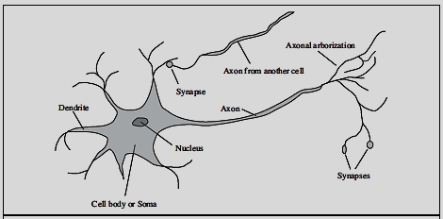
Neuron

Slide 20
Can Computers Talk?
This is known as “speech synthesis”
translate text to phonetic form
e.g., “fictitious” -> fik-tish-es
use pronunciation rules to map phonemes to actual sound
e.g., “tish” -> sequence of basic audio sounds
Difficulties
sounds made by this “lookup” approach sound unnatural
sounds are not independent
e.g., “act” and “action”
modern systems (e.g., at AT&T) can handle this pretty well
a harder problem is emphasis, emotion, etc
humans understand what they are saying
machines don’t: so they sound unnatural
Conclusion:
NO, for complete sentences
YES, for individual words

Slide 21
Can Computers Recognize Speech?
Recognizing single words from a small vocabulary
systems can do this with high accuracy (order of 99%)
e.g., directory inquiries
limited vocabulary (area codes, city names)
computer tries to recognize you first, if unsuccessful hands you over to a human operator
saves millions of dollars a year for the phone company

Slide 22
Recognizing human speech (Contd…)
Recognizing normal speech is much more difficult
speech is continuous: where are the boundaries between words?
e.g., “John’s car has a flat tire”
large vocabularies
can be many thousands of possible words
we can use context to help figure out what someone said
e.g., hypothesize and test
try telling a waiter in a restaurant: “I would like some dream and sugar in my coffee”
background noise, other speakers, accents, colds, etc
on normal speech, modern systems are only about 60-70% accurate
Conclusion:
NO, normal speech is too complex to accurately recognize
YES, for restricted problems (small vocabulary, single speaker)

Slide 23
Can Computers Learn and Adapt ?
Learning and Adaptation
consider a computer learning to drive on the freeway
we could teach it lots of rules about what to do
or we could let it drive and steer it back on course when it heads for the embankment
systems like this are under development (e.g., Daimler Benz)
e.g., RALPH at CMU
in mid 90’s it drove 98% of the way from Pittsburgh to San Diego without any human assistance
machine learning allows computers to learn to do things without explicit programming
many successful applications:
requires some “set-up”: does not mean your PC can learn to forecast the stock market or become a brain surgeon
Conclusion: YES, computers can learn and adapt, when presented with information in the appropriate way

Slide 24
Can Computers “see”?
Recognition v. Understanding (like Speech)
Recognition and Understanding of Objects in a scene
look around this room
you can effortlessly recognize objects
human brain can map 2d visual image to 3d “map”
Why is visual recognition a hard problem?
Conclusion:
mostly NO: computers can only “see” certain types of objects under limited circumstances
YES for certain constrained problems (e.g., face recognition)

Slide 25
Intelligent Systems in Your Everyday Life
Post Office
automatic address recognition and sorting of mail
Banks
automatic check readers, signature verification systems
automated loan application classification
Customer Service
automatic voice recognition
The Web
Identifying your age, gender, location, from your Web surfing
Automated fraud detection
Digital Cameras
Automated face detection and focusing
Computer Games
Intelligent characters/agents

Slide 26
Lecture Summary
Artificial Intelligence involves the study of:
automated recognition and understanding of signals
reasoning, planning, and decision-making
learning and adaptation
AI has made substantial progress in
recognition and learning
some planning and reasoning problems
…but many open research problems
AI Applications
improvements in hardware and algorithms => AI applications in industry, finance, medicine, and science.
Rational agent view of AI

